Slide 1
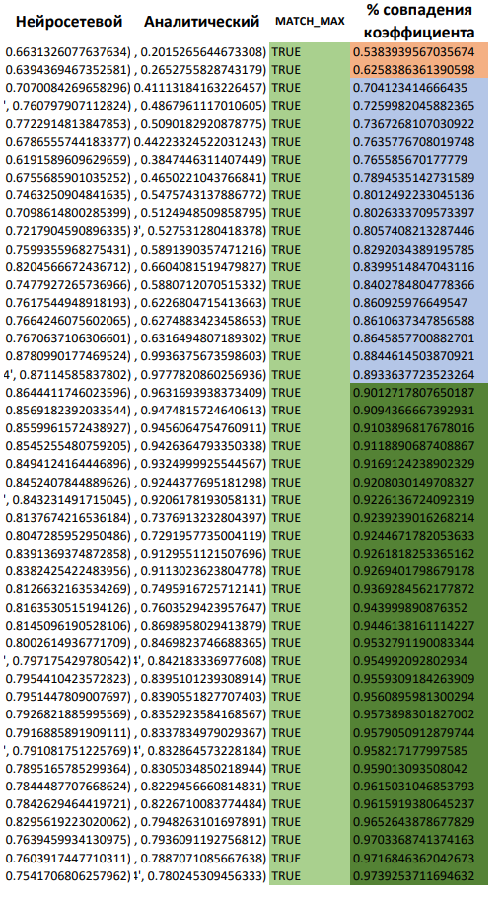
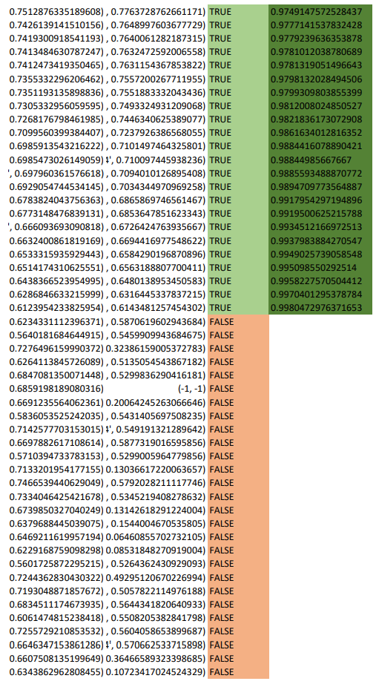
NEURAL TIME:
0.018987655639648438
ANALYTIC TIME:
9.46300220489502

